Slide 1

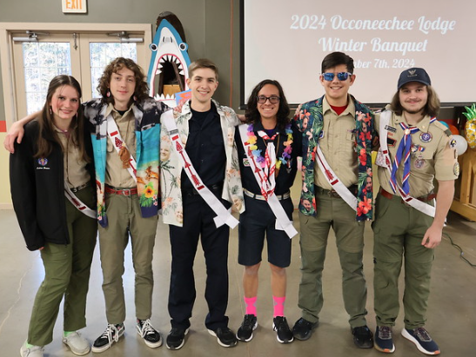
Image: Lodge officers @ WB
2025 New Member Forum
Notes:
While candidates are filing in: Play hype music ask to sit down at a table where the letters are.

Slide 2
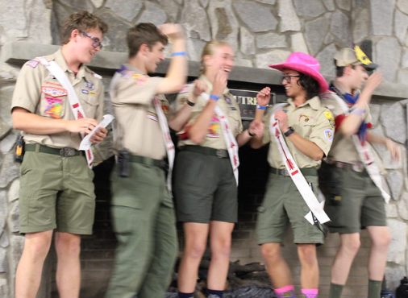
Congratulations!
You finished the Ordeal
The hard part is over
Now you can have fun

Slide 3
A little bit about me…
Jessica Fleming
Been in OA 3 years
Ceremonialist and Dancer
Eluwak Chapter Chief
New Member Development Chairman

Slide 4
Official OA Information
Scouting’s National HONOR Society
Founded in 1915 by E. Urner Goodman
Brotherhood through Cheerful Service
Service Organization

Slide 5
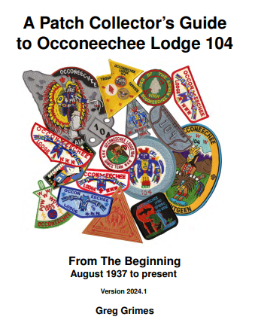
Occoneechee Lodge 104
Established in August of 1937
10 Chapters
Camp Durant

Slide 6
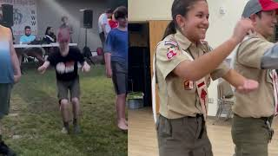
We Are Occoneechee!!
Notes:
Move to video: not in slides

Slide 7
OCCONEECHEE
Notes:
Thundy

Slide 8
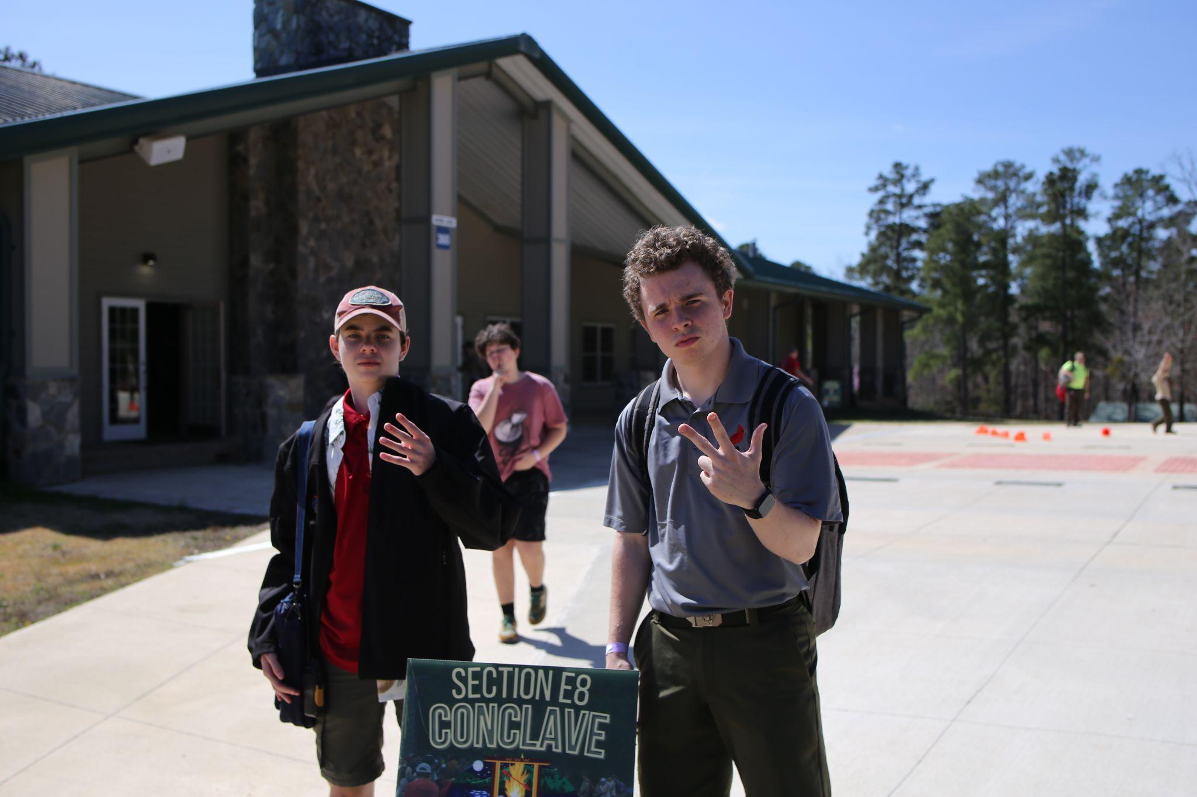
OA Structure
National
Region: Eastern
Section: E8
Lodge: 104
Chapters
Notes:
National: Covers the entire Nation ( US And a bit more)
Region: Split into 2 regions; Region Chief; NLS
Section: Collection of Lodges in your area (for us: Almost statewide) E8. Conclave
Lodge: Each Lodge is connected to a Council. Our lodge happens to share a name with our council. We are Lodge #104
Chapters: Make up a lodge, we have 10 of them, a couple per district; Chapter members are all units’ arrowmen from their part of the District (i.e. Ilau Machque covers Cardinal South)

Slide 9
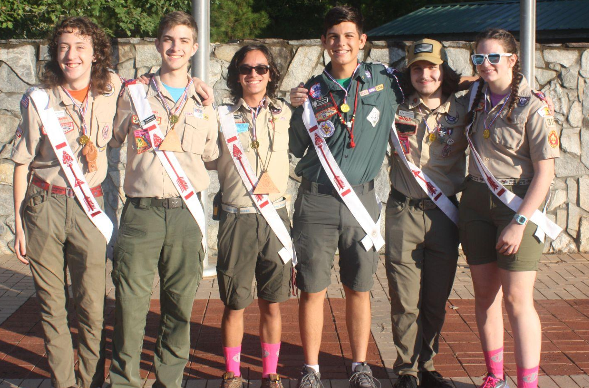
Your Lodge Leadership
Lodge Chief- Gabriel Almario
VC Program- Luke Frassel
VC Admin- Zachary Sandman
VC Communications- Trevor Rubino
VC Finance- Robert Francis
Conclave Chair- Lalan Brewer
Lodge Adviser- John Bardin
Lodge Staff Adviser- Michael Morrell

Slide 10
04!!
Thunderbird!!
We’re Number 1
Pass the Word
Notes:
Chapter chiefs.
Option A:
Song: Swag Surfin (Or other suggestion)
Chiefs come in from doors by the fireplace
We meet in center
Huddle
Options A.2:
Song: Swag Surfin (Or other suggestion)
Chiefs come in from all doors
We meet in center
Huddle
Option B:
Song: Cotton Eye Joe
Chiefs come in from doors that overlook waterfront
Meet Jessica
Cotton Eye Joe
Fade it and get chants going

Slide 11
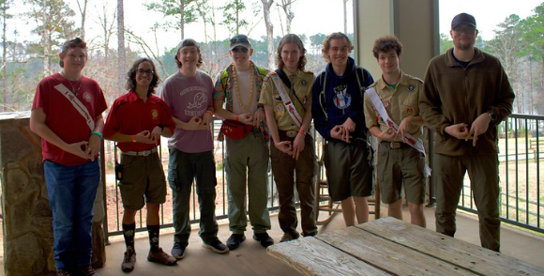
Your Chapter Leadership
Chapter Chiefs:
Eluwak- Jessica Fleming
Ilau Machque- Keifer Froom
Kiowa- Ian Davies
Lauchsoheen- Xander Stockigt
Netami- Mason Welch
Netopalis- Lily Davis
Neusiok- Cole Samples
Mimahuk- Aiden Lampman
Temakwe- Liam Vigeant
Saponi- Andrew Work
Notes:
Chapter leadership reflects the Lodge Leadership. If you aren’t sure what a position entails ask the current chapter vice-chief, lodge vice-chief or check out the roles of the lodge vice-chief and see what translates well to Chapter level. (I.E. Chapter VC comms and Troop Reps)

Slide 12
104 104 104 104 104 104
Notes:
Chapter chiefs.
Option A:
Song: Swag Surfin (Or other suggestion)
Chiefs come in from doors by the fireplace
We meet in center
Huddle
Options A.2:
Song: Swag Surfin (Or other suggestion)
Chiefs come in from all doors
We meet in center
Huddle
Option B:
Song: Cotton Eye Joe
Chiefs come in from doors that overlook waterfront
Meet Jessica
Cotton Eye Joe
Fade it and get chants going

Slide 13
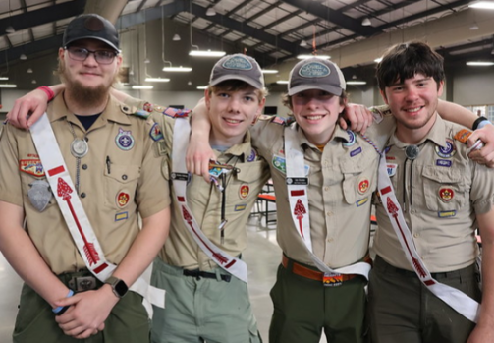
Finding Your “Why”
Why did you complete your Ordeal?
Why do you keep coming back?

Slide 14
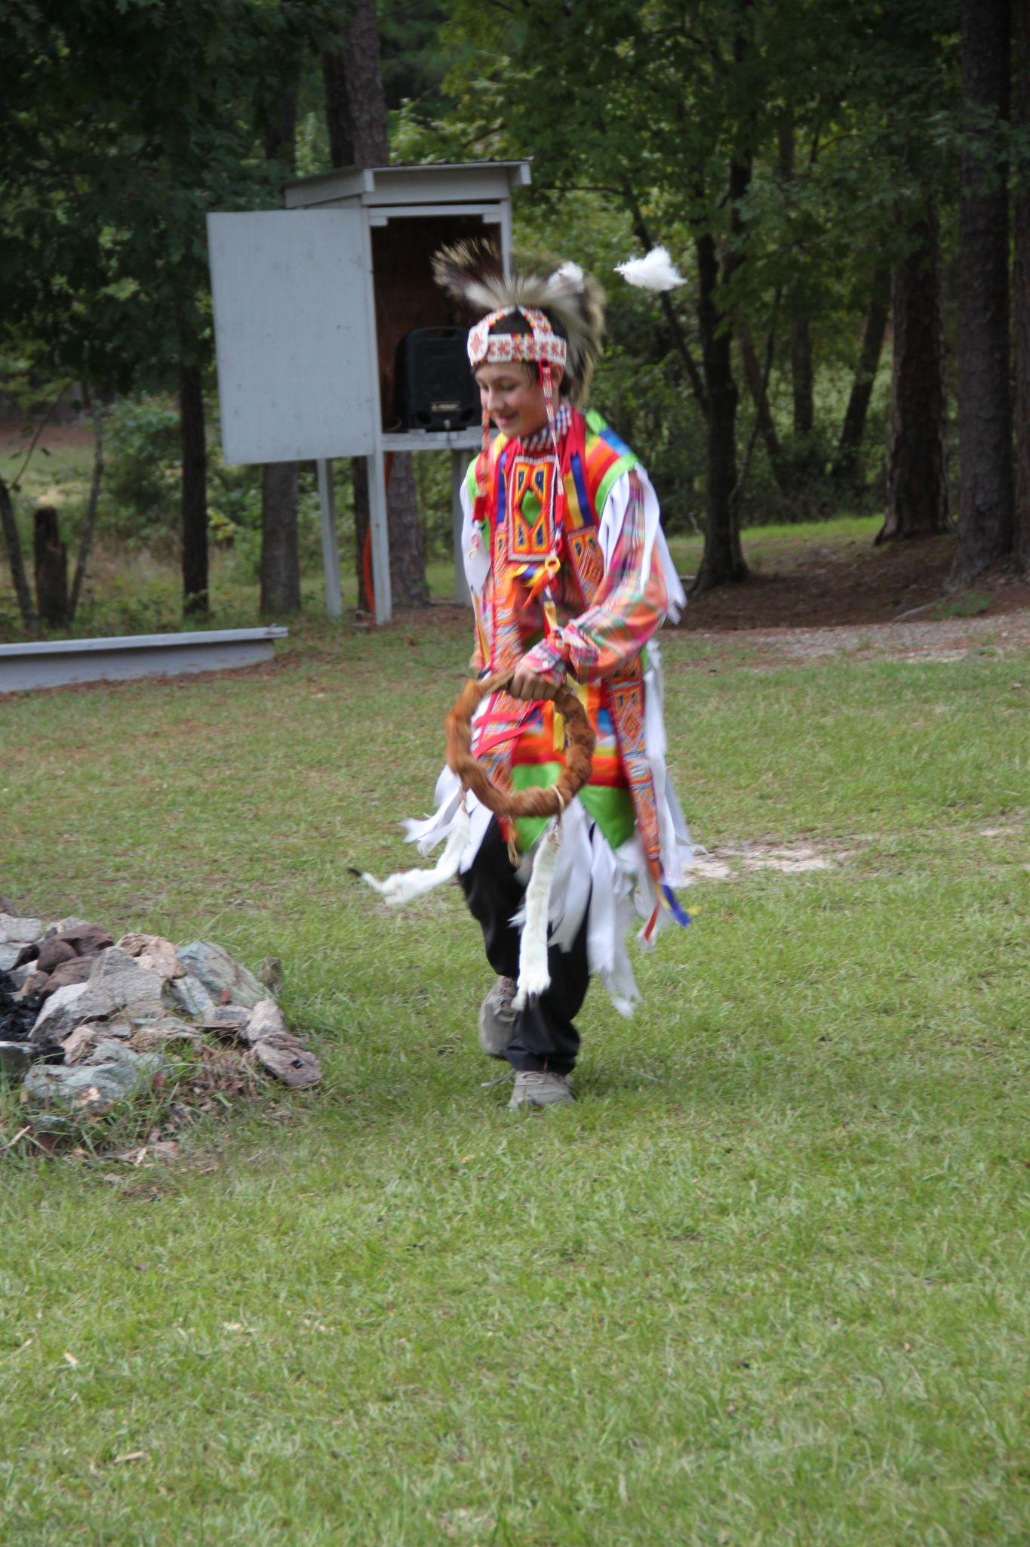
OA Opportunities
Summer Camp
OAHA
Trade-o-ree
Gentgeen
Fall Fellowship
Conclave
Notes:
CONCLAVE IS BEING HOSTED BY OCCONEECHEE IN 2026!!!!
Find your WHY
Last Year WB had 300. Let’s get to 400!
Nearly 1000 at conclave yearly
National:
OAHA
NOAC
NLS
Also Trade-o-ree, Gentgeen and Spring Inductions
Patch Trade!
AIA!
Service!
Thunderfest!
Hang Out With Friends!

Slide 15
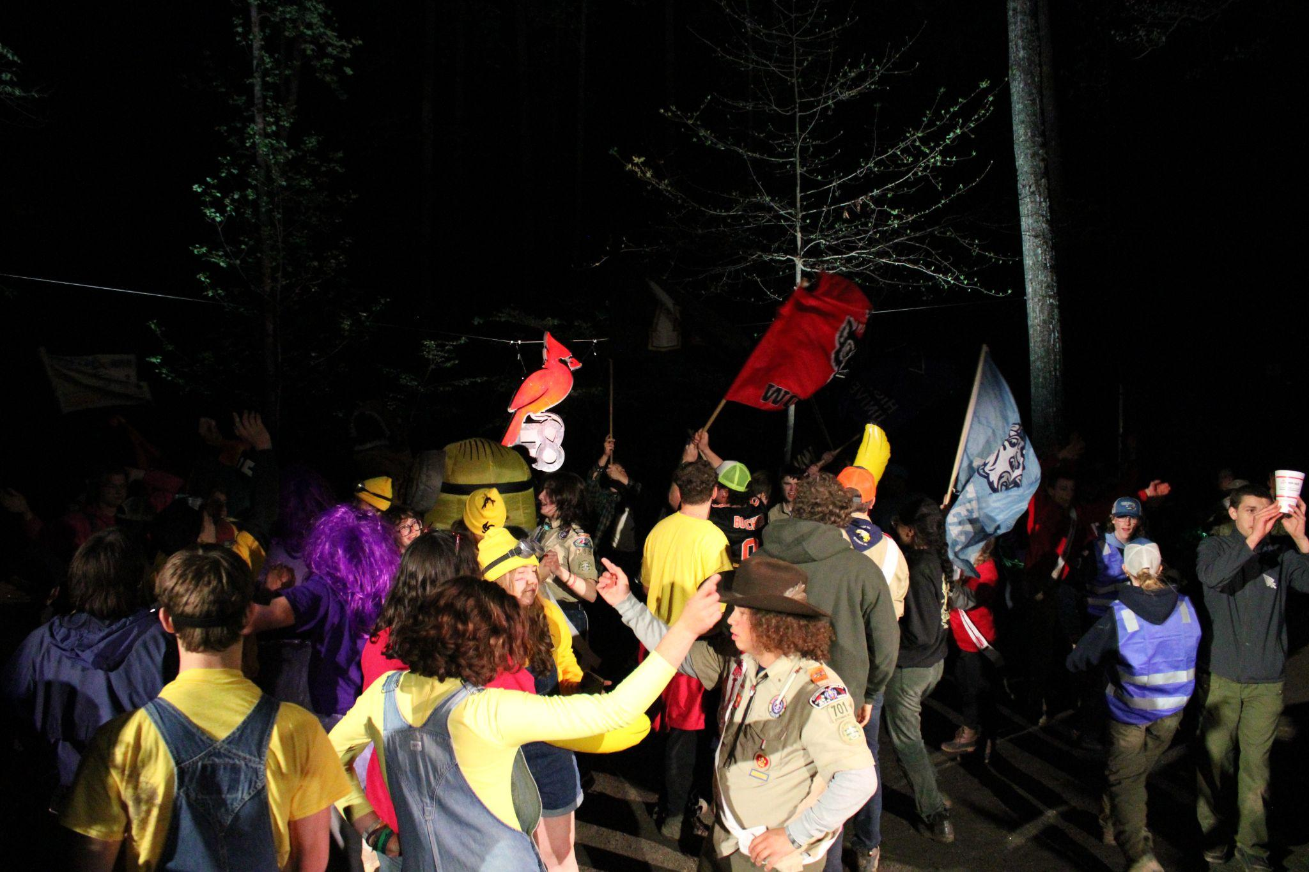
Conclave 2026
Held at Camp Durant
Your first Conclave
Whole load of fun
Theme: Ice Company

Slide 16
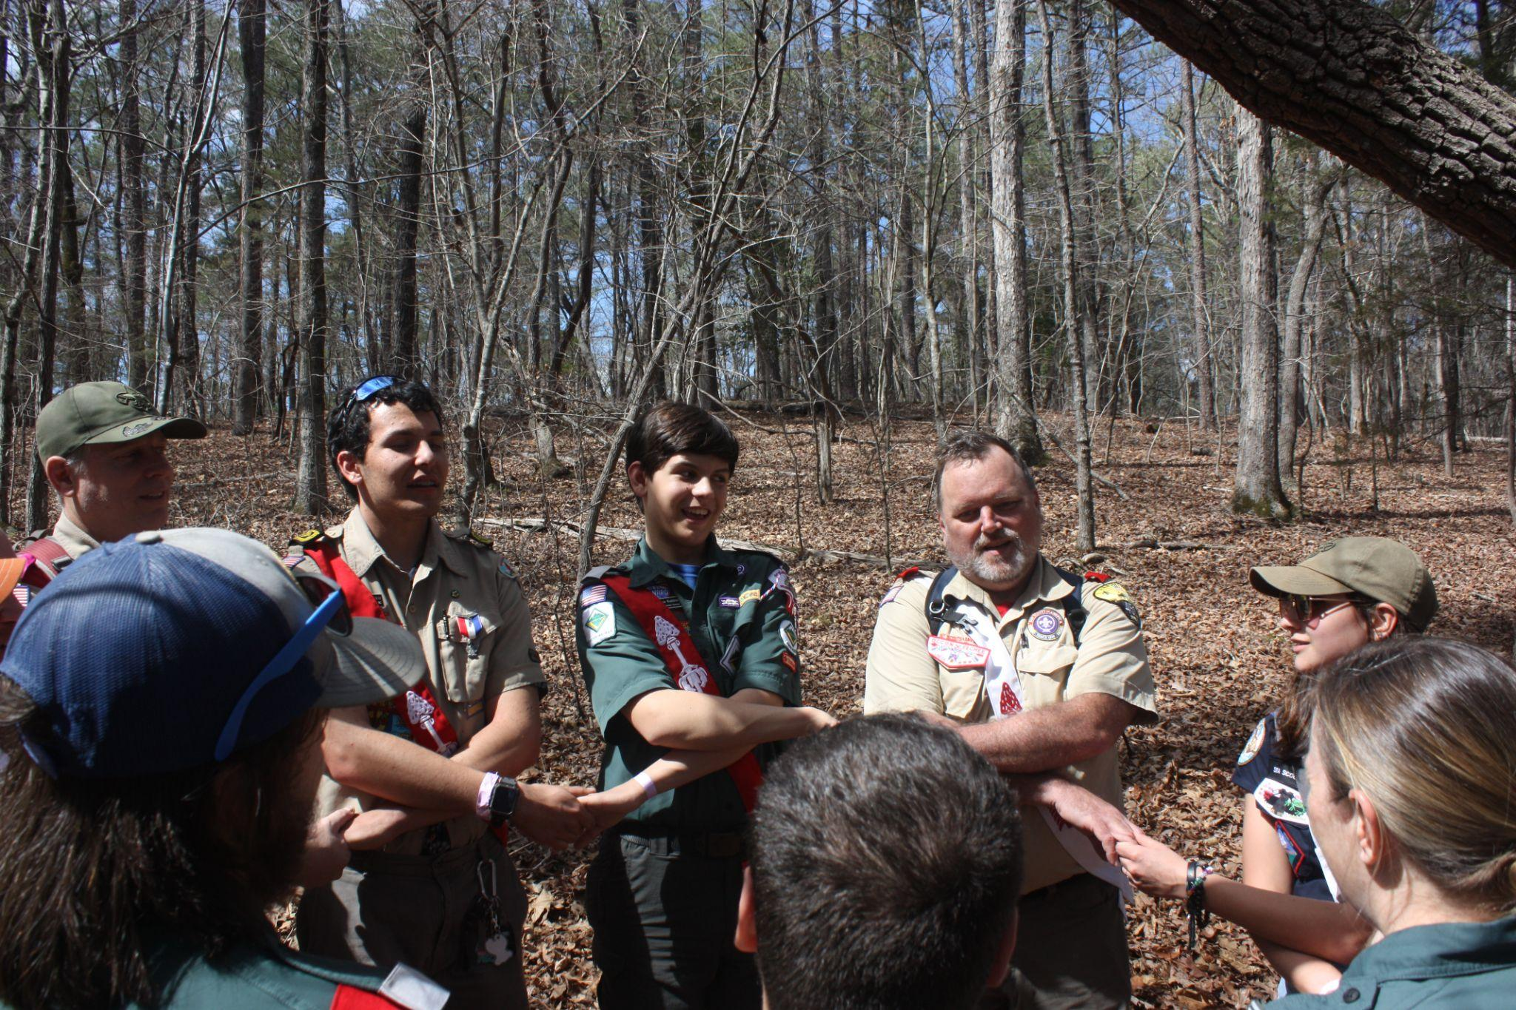
Journey to Brotherhood
Your induction is NOT complete
Brotherhood!
Spring Pow-Wow
Notes:
Chocolate Bars = Brotherhood
Next level of commitment. Involves understanding the Ordeal, it’s challenges and ceremony. Also involves writing a letter of what you have done, will do and what the OA means to you.

Slide 17
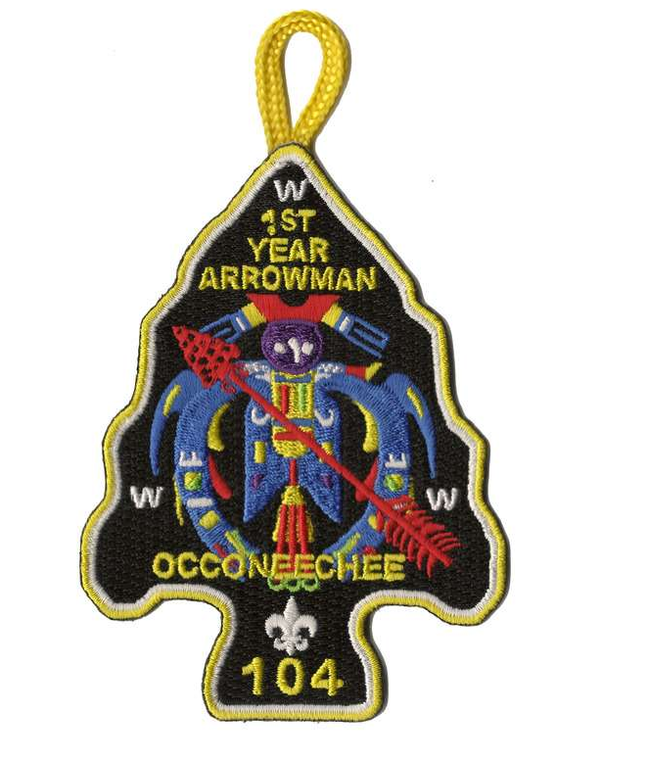
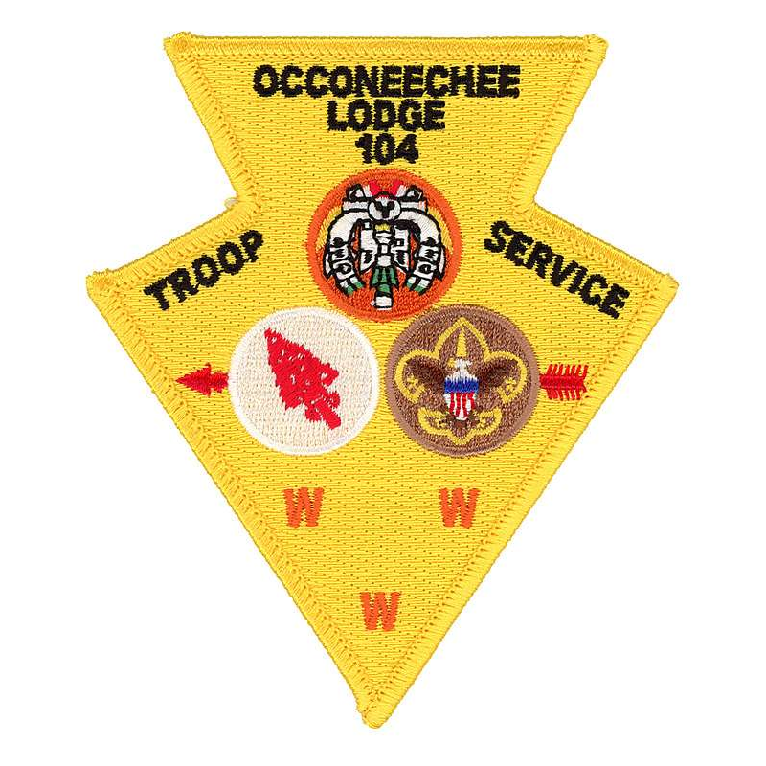
Awards
There are many awards that the OA offers
They include, but are not limited to:
First Year Arrowman Award, Troop Service Award, Ceremonies Award, and many more
Interested? Visit
lodge104.net/downloads/
Notes:
Cool patch for Awards

Slide 18
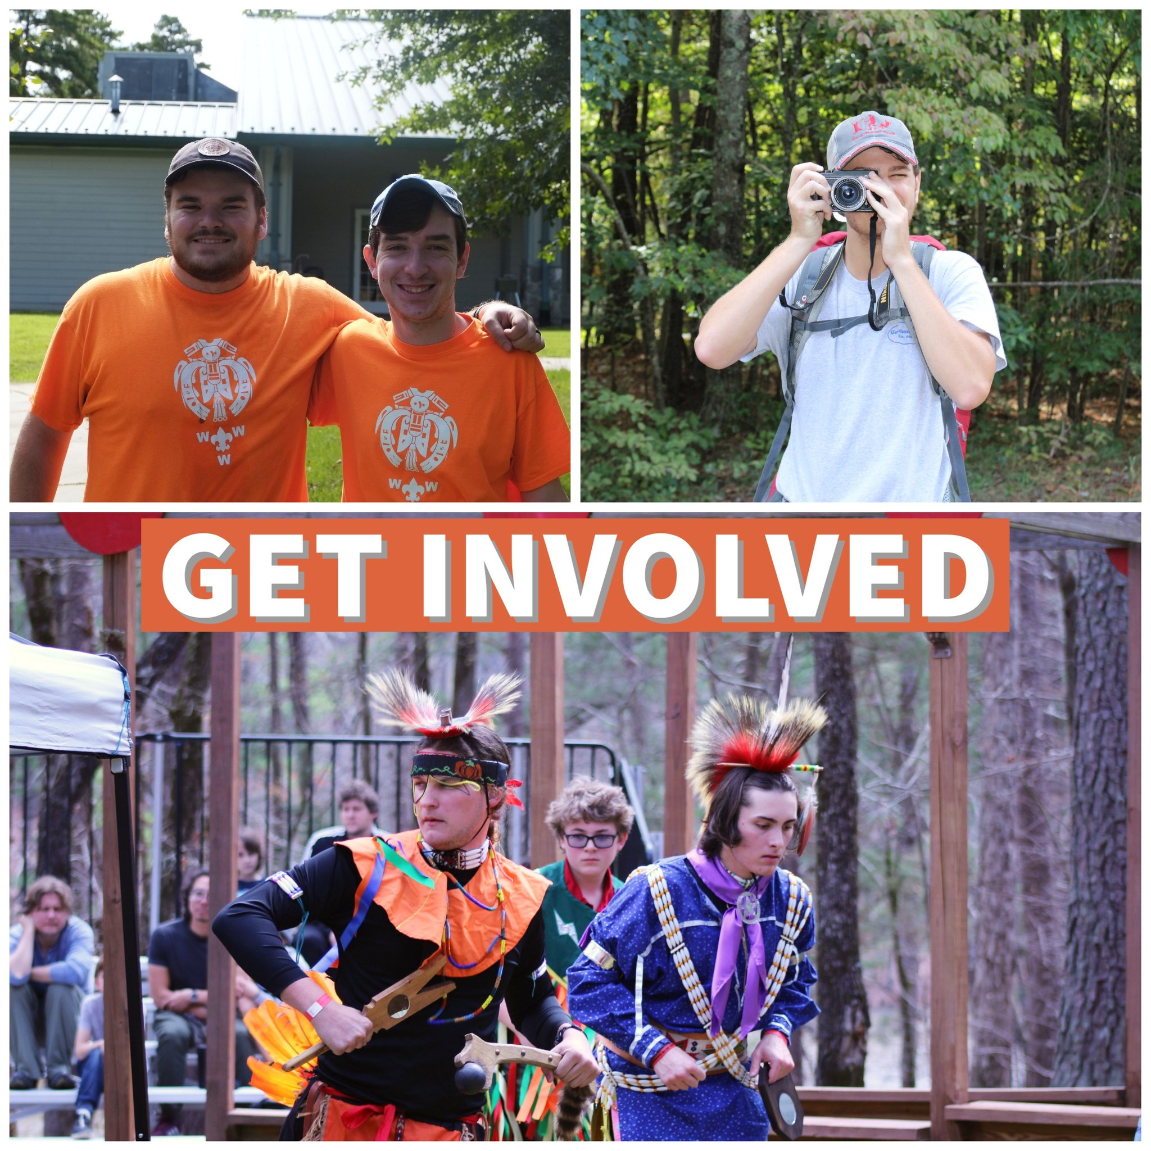
Get Involved
Plenty of Opportunities
Lots of people are needed
https://lodge104.net/get-involved
Notes:
The Lodge does alot. We can’t function without our committees. If you’d like to help out please join a committee!

Slide 19
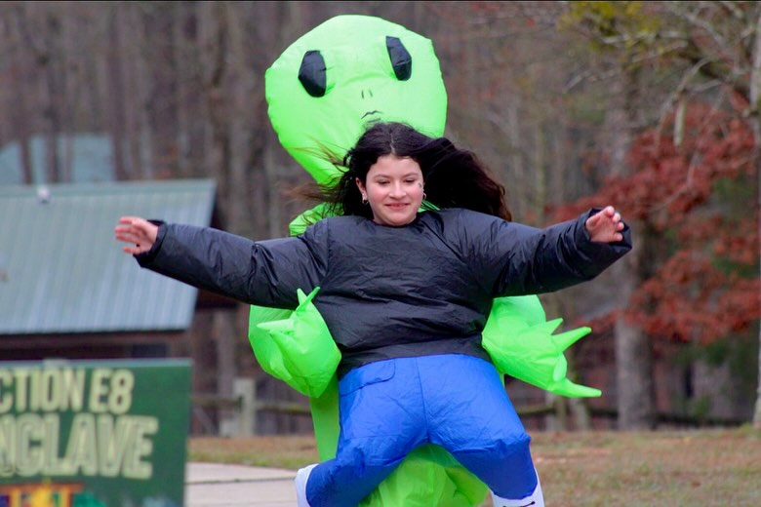
What to do NOW!
Get to know your chapter!
Get involved in your theme!
Show up to flags tomorrow morning with SPIRIT!
Notes:
Slow Down

Slide 20
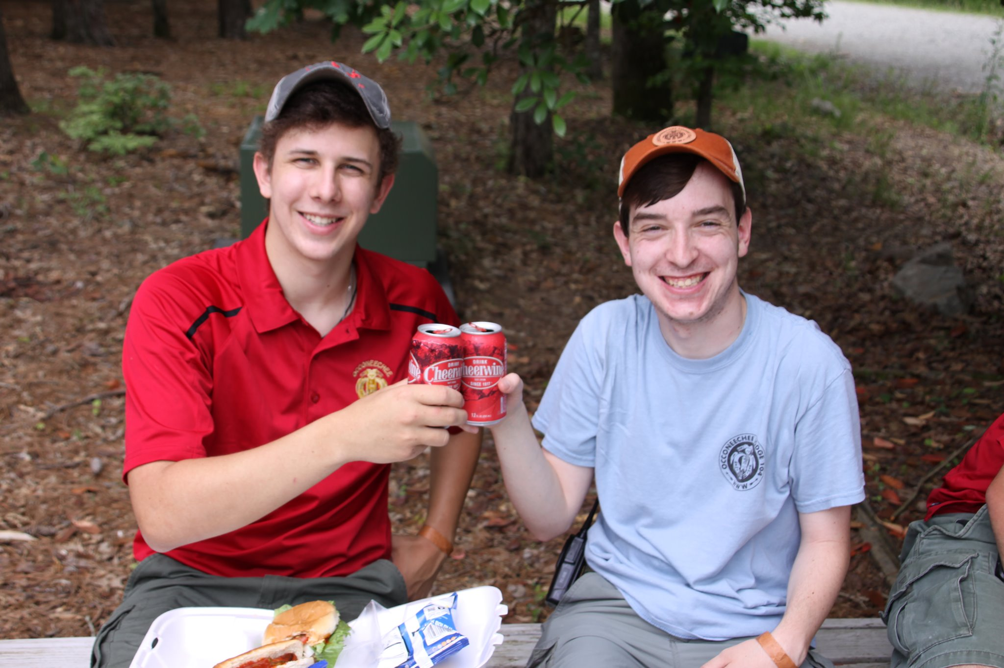
What is next for you
Go to your first Chapter meeting
Stay active
Brotherhood
Notes:
When you join our Lodge. You don’t just join the OA. You join our Brotherhood: Occoneechee Lodge

Slide 21
OOOOOOOOOOOOOOOOO-
-CCONEECHEE

Slide 22
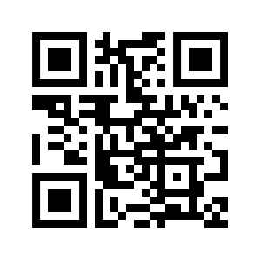
Linktree
linktr.ee/lodge104

Slide 23
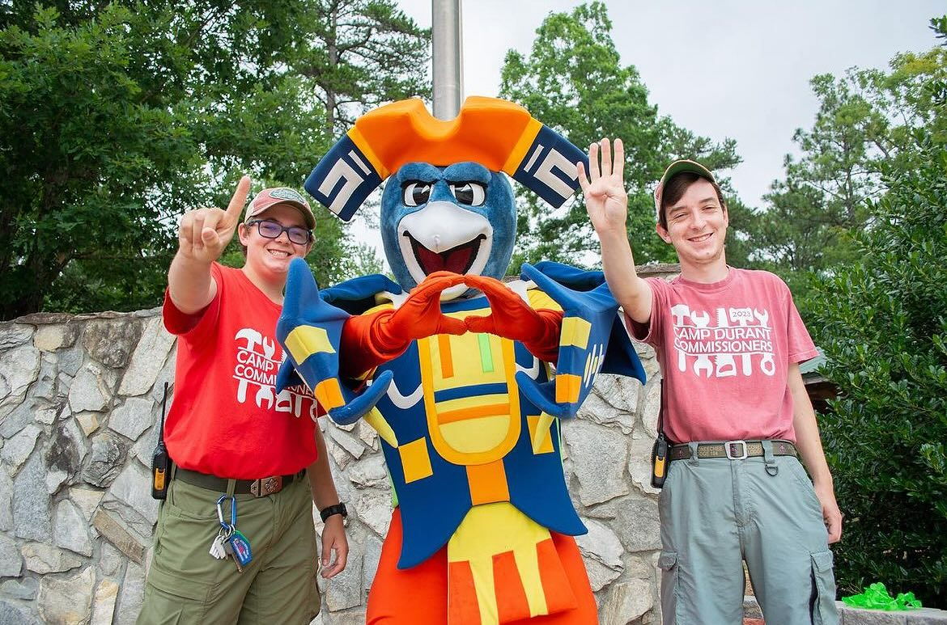
Questions?

Slide 24
Thank you!
Welcome to the OA!
Notes:
Pass of to Ordeal committee to sort clans into chapters or do self with the list

